Slide 1
Module 1: RNA-sequencing
Dana Nachmanson
01/07/2020

Slide 2
RNA-seq workflow
RNA Isolation and Fragmentation
Library Preparation
Sequencing
Alternative
strategies
Notes:
EST: expressed sequence tag

Slide 3
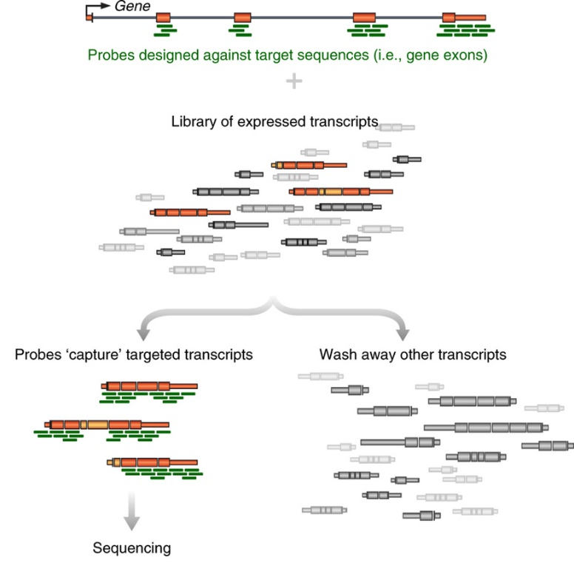
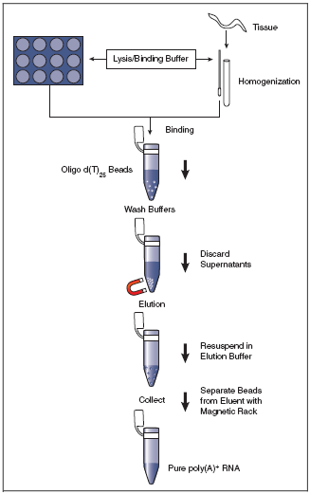
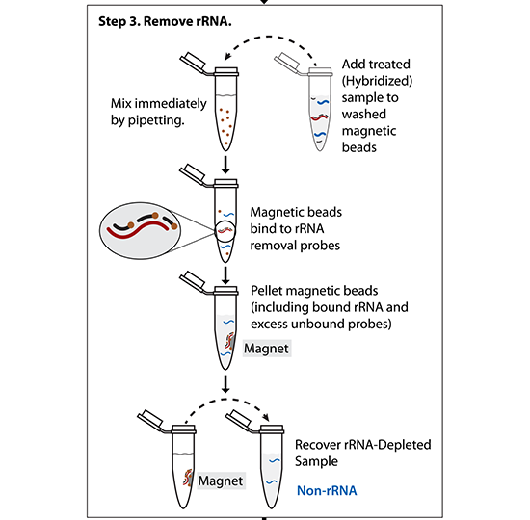
RNA Enrichment
mRNA only -> PolyA selection
rRNA-depleted RNAs -> rRNA negative selection
Specific RNAs -> targeted enrichment
(All mRNAs are polyadenylated at the 3’ end – can use d(T)₂₅ beads to select)
(Probes matching rRNA are used to pull-out rRNA molecules)
(Other methods – hybridize targeted DNA oligos + RNAseH treat)

Slide 4
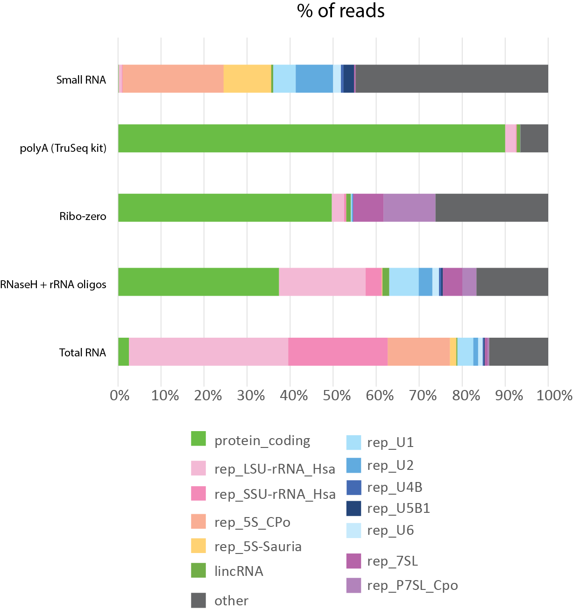
RNA Isolation: Types of RNA extracted
Preparation method greatly impacts the over profile of your library
Notes:
LSU: large subunit ribosomal RNA

Slide 5
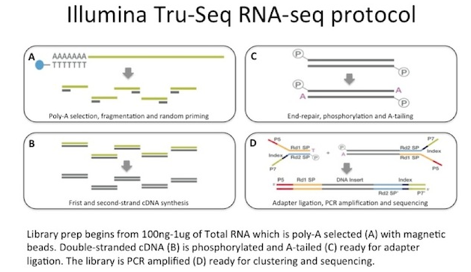
Library Preparation - TruSeq

Slide 6
Strand Information: why to retain it
Accurately identifies antisense transcripts
Determines transcribed strand of non-coding RNA (e.g. lincRNAs)
Demarcates transcripts from overlapping genes
Illumina RNA ligation method
dUTP method

Slide 7
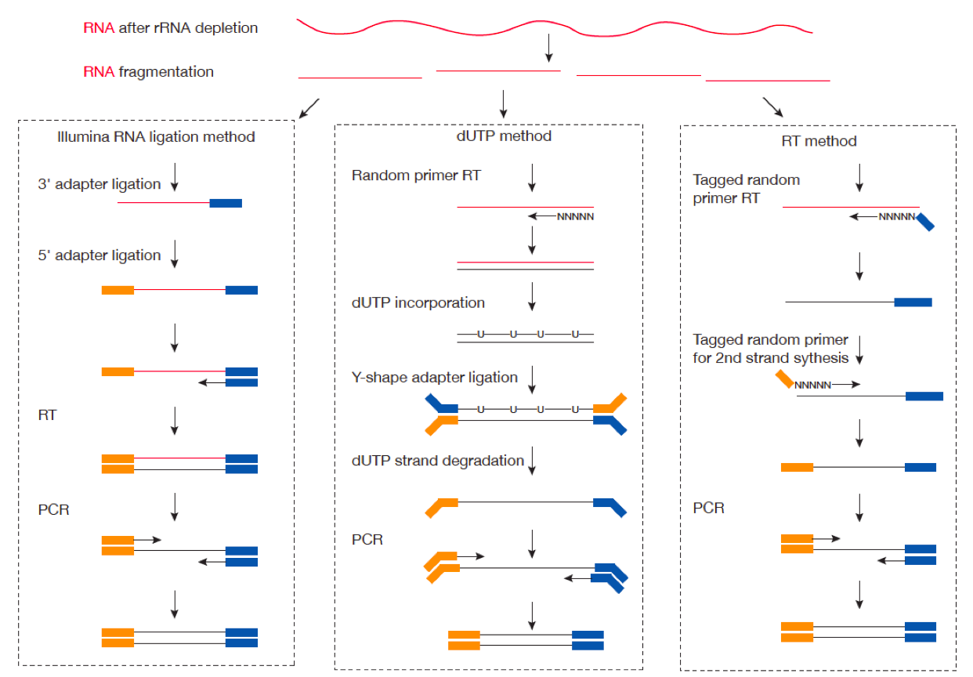
Strand Information: how to retain it

Slide 8
RNA sequencing strategies
Makes up 95% of data in SRA
Stark et al, Nature Reviews, 2019

Slide 9
RNA-Seq mapping by sequencing strategy
Great for isoform
discovery!
Stark et al, Nature Reviews, 2019
Notes:
Technology features very high throughput: currently 100–1,000 times more reads per run than long-read platforms • Biases and error profiles are well understood (homopolymers are still an issue for Ion Torrent) • A huge catalogue of compatible methods and computational workflows are available • Analysis works with degraded RNA

Slide 10
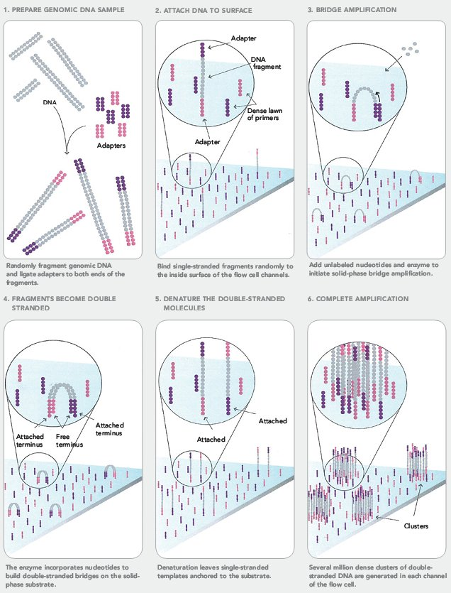
Sequencing on Illumina Flowcell
https://www.youtube.com/watch?v=fCd6B5HRaZ8

Slide 11
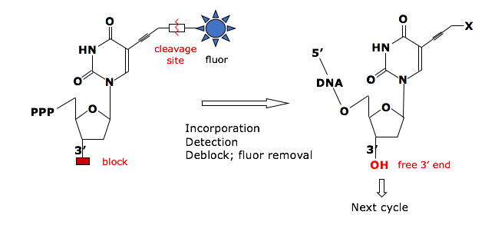
Sequencing by Synthesis
Reversible Terminator Chemistry
3’-
…-5’
5’-
G
T
A
T
T
T
T
C
G
G
C
A
C
A
G
A
G
A
C
T
T
C
T
G
Cycle 1: Add sequencing reagents
First base incorporated
Remove unincorporated bases
Detect signal
Cycle 2-n: Add sequencing reagents and repeat

Slide 12
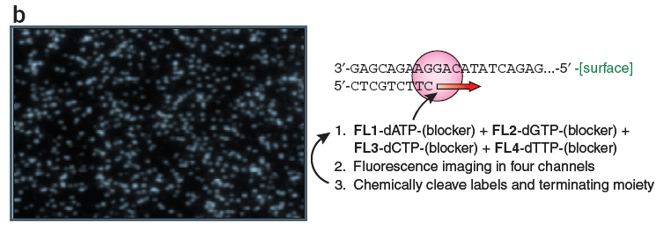
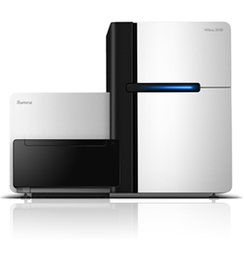
Sequencing by synthesis: HiSeq 2500 (Illumina)
Shendure & Lee, Nat. Biotech. 2008
Can do 50bp to 250bp single-end or paired-end reads
~300 million reads per lane x #lanes
4-8 days run time
200 billion bp output each run
Notes:
12

Slide 13
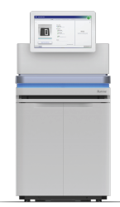
Sequencing by synthesis: NovaSeq (Illumina)
Shendure & Lee, Nat. Biotech. 2008
Can do 50bp to 250bp single-end or paired-end reads
~1.5-3 BILLION reads per lane x #lanes
0.5-2 days run time
500-1000 billion bp output each run
Notes:
13

Slide 14
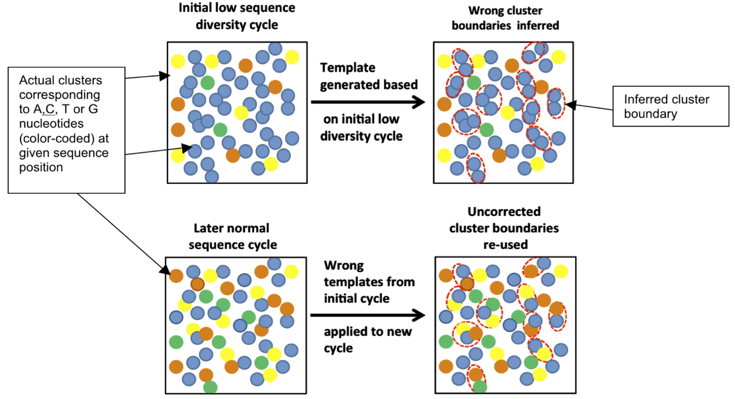
Key considerations
“Cluster Density” = how many clusters are there per mm²
If too high, hard to properly draw cluster boundaries
“Library Complexity” = how diverse are the sequences?
Illumina identifies clusters in the first 5 cycles – if those 5 cycles are identical for nearby clusters, the software doesn’t know to split them into two
Mitra, A. et al. Plos ONE (2015)
Notes:
How can you solve a problem like this?
Decrease cluster density – works, but lose sequencing power
Artificially add complexity
Spike in other libraries
Add random-mers

Slide 15
Illumina sequencing – fragment strategy
I5 adapter
Read1 primer
DNA insert (your library)
Read2* primer
I7 adapter
Flow Cell Surface
I5 index*
I7 index*
* optional
Reaction #
Flow Cell Surface
1
Read1 primer
Read1 sequence
Flow Cell Surface
2*
Index1 primer
Index1 sequence

Slide 16
Illumina sequencing – Paired End & Dual Indexing
Reaction #
Flow Cell Surface
1
Read1 primer
Read1 sequence
Flow Cell Surface
2*
Index1 primer
Index1
(I7) sequence
Flow Cell Surface
3*
Index2 primer
Index2
(I5) sequence
Flow Cell Surface
4*
Read2 primer
Read2
sequence
* optional

Slide 17
Workflows for DGE
Notes:
In workflow A, aligners such as TopHat¹¹², STAR¹¹³ or HISAT2 (ref.¹¹⁴) use a reference genome to map reads to genomic locations, and then quantification tools, such as HTSeq¹³³ and featureCounts¹³⁴, assign reads to features. After normalization (usually using methods embedded in the quantification or expression modelling tools, such as trimmed mean of M-values (TMM)¹⁴²), gene expression is modelled using tools such as edgeR¹⁴³, DESeq2 (ref.¹⁵⁵) and limma+voom¹⁵⁶, and a list of differentially expressed genes or transcripts is generated for further visualization and interpretation. In workflow B, newer, alignment-free tools, such as Kallisto¹¹⁹ and Salmon¹²⁰, assemble a transcriptome and quantify abundance in one step. The output from these tools is usually converted to count estimates (using tximport¹³⁰ (TXI)) and run through the same normalization and modelling used in workflow A, to output a list of differentially expressed genes or transcripts. Alternatively, workflow C begins by aligning the reads (typically performed with TopHat¹¹², although STAR¹¹³ and HISAT¹¹⁴ can also be used), followed by the use of CuffLinks¹³¹ to process raw reads and the CuffDiff2 package to output transcript abundance estimates and a list of differentially expressed genes or transcripts. Other tools in common use include StringTie¹¹⁶, which assembles a transcriptome model from TopHat¹¹² (or similar tools) before the results are passed through to RSEM¹⁰⁵ or MMSEQ¹³² to estimate transcript abundance, and then to Ballgown¹⁵⁷ to identify differentially expressed genes or transcripts, and SOAPdenovo-trans¹¹⁷, which simultaneously aligns and assembles reads for analysis via the path of choice

Slide 18
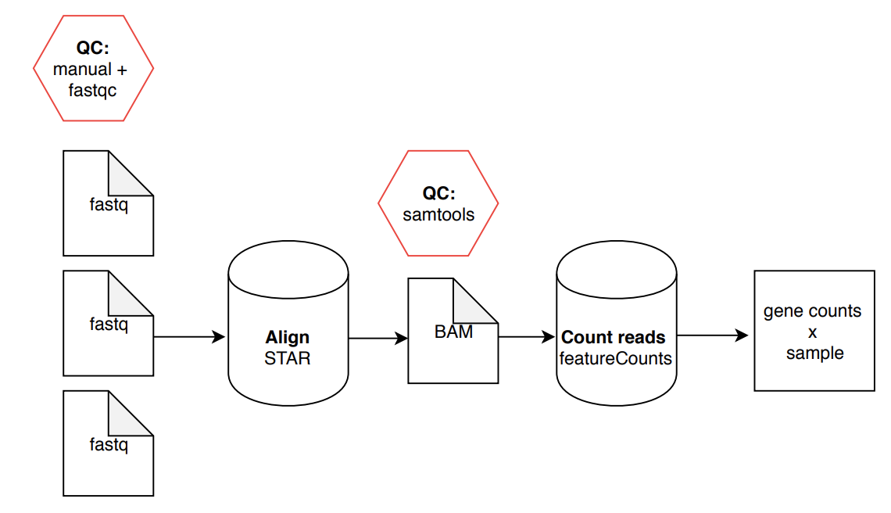
RNA-Seq Analysis Overview (Part 1):

Slide 19
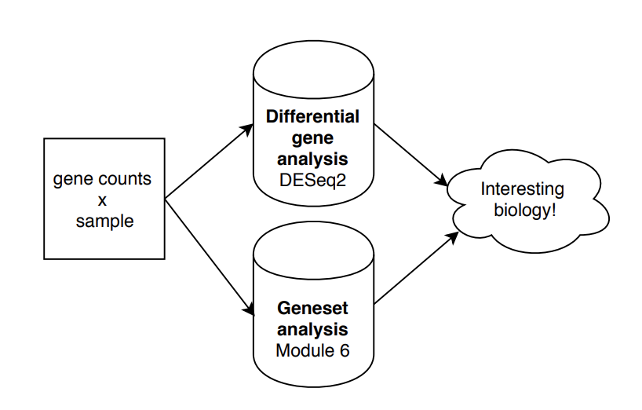
RNA-Seq Analysis Overview (Part 2):
(Or a million other things!)

Slide 20

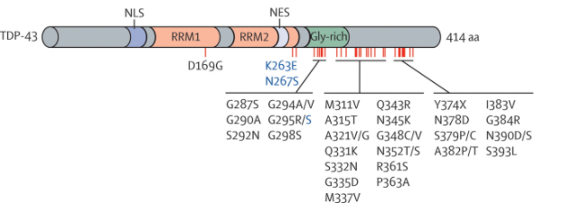
Experiment: TARDBP shRNA from ENCODE
TARDBP/TDP-43:
DNA and RNA-binding protein regulating transcription and alternative splicing
Aberrantly processed forms of TARDBP miseggregate to cytoplasm and are associated with neurodegenerative diseases (FTLD, ALS)
Dataset: What are the transcriptional consequences of TARDBP depletion?
https://www.encodeproject.org/rna-seq/long-rnas/
Each replicate should have 30 million aligned reads, although older projects aimed for 20 million reads.
Notes:
The Encyclopedia of DNA Elements (ENCODE) is a public research project launched by the US National Human Genome Research Institute (NHGRI) in September 2003. Intended as a follow-up to the Human Genome Project (Genomic Research), the ENCODE project aims to identify all functional elements in the human genome.

Slide 21
Replicate concordance
Isogenic replicates
HEP2G cell line
WT 1 | WT 2 | KO 1 | KO 2
Anisogenic replicates
Gene level quantification should have a Spearman correlation of >0.9 between isogenic replicates and >0.8 between anisogenic replicates (i.e. replicates from different donors).

